Slide 1
Model 4 Introduction to Operating System Security
Lesson 1: Security functions in OS

Slide 2
Module 4: Introduction to Operating System Security
Module Description:
The intent of this Knowledge Unit is to provide students with an understanding of networking and internet protocols.
Topics:
Lesson 1: Iworking overview
Lesson 2: Secure OS design principles

Slide 3
Lesson 1: Security functions in OS
Topics:
An overview of operating systems.
System resources which need protection from the OS.
Security functions provided by OS
Virtualization
Segmentation
Paging
Tagged architecture
Learning Outcomes:
Upon completion of this lesson:
Students will be able to identify the system resources which require protection by the operating systems.
Students will be able to describe the security functions provided by the OS.

Slide 4
Operating systems
An operating system is a program that works as an intermediary between the user applications and the computer hardware.
The OS manages the hardware resources, so that it provides an environment in which a user can execute programs and software easily on a computer system.
Modern operating systems (and even some older systems) are multiuser and multiprocessing systems.

Slide 5
OS Overview
A user executes a program that generally consists of one process.
A process is assigned system resources
Memory the program can use
State (registers, program counter, stack pointer)
access to devices and communications
A process can create other processes.
The operating system keeps track of all processes by using a process table.

Slide 6
OS Overview (cont.)
The operating system switches control back and forth between processes, allocating, deallocating, and reallocating resources each time a different process is activated.
A process consists of one or more threads.
A thread may include one or more tasks.

Slide 7
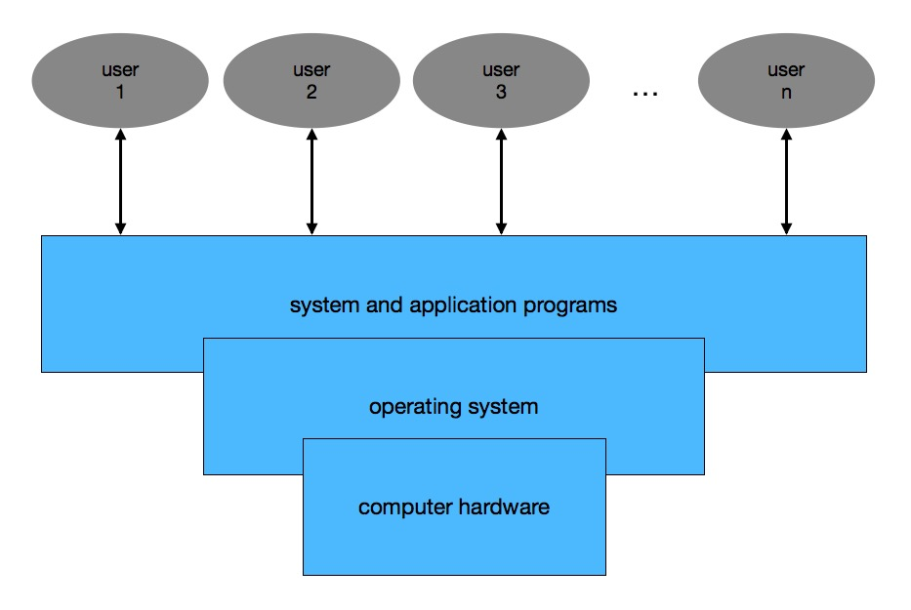
Figure: OS Overview

Slide 8
Discussion:
If there are multiple users sharing an operating system:
What need be protected?
What protections are provided by the operating system to protect different users’ data?

Slide 9
Objects that need protection
Memory
Sharable I/O devices, such as disks
Reusable I/O devices, such as printers
Sharable programs
Networks
Sharable files

Slide 10
Security Features in OS
User authentication.
Memory protection.
Interface to hardware.
Allocation of objects.
Access control to objects, file and I/O devices.
Protection of operating system data and code.

Slide 11
Security functions provided by OS
Access control
A subject is permitted to access an object in a particular mode.
Audit
A log of which subject accessed which object is maintained.
Separation
Separation can be supported by space, time, access control, or cryptography.
Virtualization
Virtualization provides a simulated environment by VM.
Hardware protection of memory
Segmentation, paging…

Slide 12
Virtualization
With virtualization, the OS presents each user with just the resources that user needs.
The user has access to a virtual machine (VM), which contains those needed resources. The user cannot access to the resources outside the VM.
Virtual machine (VM) - Software that allows a single host to run one or more guest operating systems.
A hypervisor, or VM monitor, is the software that implements a VM.

Slide 13
Virtualization security
Concerns:
How to ensure that the programs running within a guest OS may only access to the resources allocated to it?
Is it possible for unauthorized parties to access the image or screenshot of the VM?
How to secure the VM monitor or hypervisor?
How to control privileged access to some of the program resources in the guest OS?

Slide 14
Separation
Separation can be supported by space, time, access control, or cryptography.
• separation by space
• Use different physical resources for different users
• Easy to implement, but expensive
• separation by time
• Execute different users’ programs at different times
• Easy to implement, time consuming
• separation by access control
• access control applied to objects
• needs maintain from the OS
• separation by cryptography
• Encrypt data so other users cannot read it without the decryption key
• Complex

Slide 15
Hardware Protection of Memory
Preventing one process from affecting the memory of other processes
Built-in hardware protection mechanisms are common.
fence
fence register
base/bounds registers
segmentation
paging
combined paging with segmentation
tagged architecture

Slide 16
Fence
Introduced in single-user operating systems
Goal
Prevent a user program from interfering the OS code/data
Methods
Provides a “fence”, a predefined memory address
User is limited to one side of the “fence”
OS is protected by the “fence”
Problem
It was designed for single-user OSs. If there are more than one user in the OS, there is no protection for a user from the other users.
If the OS is getting bigger, the address of the fence cannot be changed.

Slide 17
Fence Registers
Goal
Prevent a user program from interfering the OS code and data
Methods
The location of the “fence” is specified using a register.
The address of the “fence” can be changed.
User is limited to one side of the “fence”
OS is protected by the “fence”
Problem
It was designed for single-user OSs.
If there are more than one user in the OS, there is no protection for a user from the other users.

Slide 18
Base/Bounds Registers
Goal
Protect a user resources from other users by using a pair of base register and bound register.
Mothed
Base register - provides a lower bound for programs
Bounds register – provides a upper bound for a programs
All addresses inside a program are offsets from the base address
Problem
Base/bounds register values must be changed during context switch to specify the correct space.
it does not separate program and data sections

Slide 19
Segmentation
Goal
Divide a program into multiple pieces, each of them may have different access rights
Method
Segmentation divides a program into several pieces, such as code segment, data segment…
Different piece may have different access rights associated.
A segment translation table is maintained to locate different pieces.
A memory location pair <name, offset>
Name: name of the segment
Offset: offset within the segment

Slide 20
Benefits of using segmentation
Benefits
The OS can place or move any segment to any location.
Each segment may has its own access right.
OS can check the access right when accessing the segment.
Two or more users can share access to a segment, with different access rights

Slide 21
Limitations of segmentation
Limitations
OS needs to maintain a segmentation translation table to keep track of the locations of segments.
The length of segment must be maintained, and compared with every address generated
Segmentation makes the memory space fragmented.

Slide 22
Paging
Goal
Divide a program into equal-sized pieces
Method
Memory is divided into equal-sized units, called pages.
All pages are of the same size.
Each address in a paging scheme is represented by a pair <page, offset>
Memory will not be fragmented.
Problems
Access rights can only be applied on pages.

Slide 23
Combined Paging with Segmentation
Segmentation and paging can be combined.
Programs can be broken into multiple segments, and the segments are used to fill pages.
Benefits
protection rights can be applied to segments.
paging makes the implementation efficiently.
Segments can be accessed through paging.
Problem
Extra work on maintaining tables to keep track of the locations of each segment.

Slide 24
Tagged Architecture
In the tagged architecture, metadata can be associated with every word of memory to hold information about the tagged data, such as security levels, memory types, access rights.
The metadata can be treated as a tag. It can be one bit of data or several bits.
The tags are checked every time an instruction accesses that tagged data.
Limitation:
Expensive
Requires extra work on tag checking and propagation.

Slide 25
Summary
Topics:
An overview of operating systems.
System resources which need protection from the OS.
Security functions provided by OS
Virtualization
Segmentation
Paging
Tagged architecture

Slide 26
Please attribute Dr. Jim Alves-Foss and Dr. Jia Song, University of Idaho
Except where otherwise noted, this work is licensed under https://creativecommons.org/licenses/by-nc-sa/4.0/ Not withstanding the non-commercial license terms, non-profit educational institutions are granted a non-exclusive license to adapt and use this material, with attribution. Creative Commons and the double C in a circle are registered trademarks of Creative commons in the United States and other countries. Third party marks and brands are the property of their respective holders.
Project sponsored by the National Security Agency under grant Number H98230-17-1-0199. The United States Government is authorized to reproduce and distribute reprints notwithstanding any copyright notation herein.

